Slide 1
Lab 2 fork() system call

Slide 2
fork()
Fork system call is used for creating a new process, which is called child process,
which runs concurrently with the process that makes the fork() call (parent process).

Slide 3
fork()
It takes no parameters and returns an integer value. Below are different values returned by fork().
Negative Value: creation of a child process was unsuccessful.
Zero: Returned to the newly created child process.
Positive value: Returned to parent or caller.
The value contains process ID of newly created child process.
i.e. the PID of the child process is returned in the parent

Slide 4
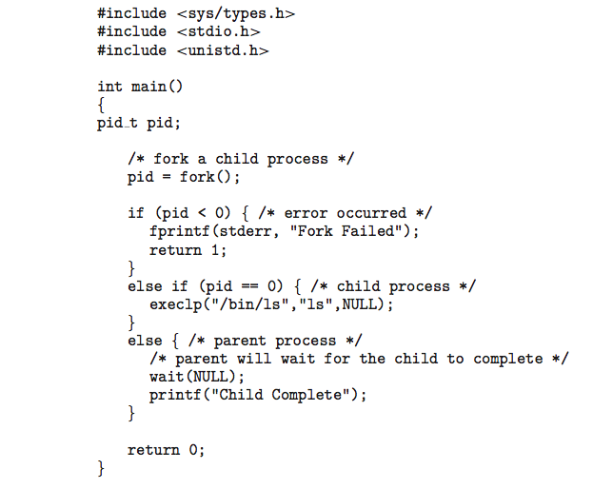
C Program Forking Separate Process

Slide 5
#include <stdio.h>
#include <sys/types.h>
#include <unistd.h>
int main()
{
// make two process which run same program after this instruction
fork();
printf("Hello world!\n");
return 0;
}

Slide 6
#include <stdio.h>
#include <sys/types.h>
#include <unistd.h>
int main()
{
// make two process which run same program after this instruction
fork();
printf("Hello world!\n");
return 0;
}
Output:
Hello world! Hello world!
After a new child process is created, both processes will execute the next instruction following the fork() system call.

Slide 7
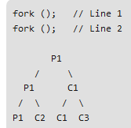
The following C program
main()
{ fork() ; fork() ; printf ("yes"); }
If we execute this core segment, how many times the string yes will be printed ? (A) Only once (B) 2 times (C) 4 times (D) 8 times
Answer: (C) Explanation: Number of times YES printed is equal to number of process created.
Total Number of Processes = 2^{n} where n is number of fork system calls. So here n = 2, 2⁴ = 4
So, there are total 4 processes (3 new child processes and one original process).

Slide 8
Header Files needed
#include <sys/types.h> /* needed to use pid_t, etc. */
#include <sys/wait.h> /* needed to use wait() */
#include <stdio.h>
#include <stdlib.h>
#include <unistd.h> /* LINUX constants and functions (fork(), etc.) */

